Slide 1


Introduction to
Robotic Process Automation
FLIGHT FARE AUTOMATION SYSTEM
Your Register No. 2116220701237
Name : SAI RUTHWIK
Guide Name : Dr. Duraimurugan. N
Designation and Department :
Associate Professor (SG) Department of Computer Science and Engineering

Slide 2
ABSTRACT
This project automates the process of searching for alternative flights and comparing prices between two locations. Developed using UiPath Studio, the workflow retrieves flight details such as departure/arrival times, airline, number of stops, and prices from airline and travel agency websites. By automating the search, it reduces time, resources, and errors compared to manual searches.
Users input their departure and arrival locations and dates, and the system collects flight data from various airline websites. The retrieved information is then organized and exported into an Excel file for easy comparison and sharing. The workflow leverages UiPath’s integration with Excel and dynamic selectors, ensuring flexibility and reliability across different websites. It is easily customizable for new routes and timeframes, making it a robust solution for flight price comparison.
Department of Computer Science and Engineering
Rajalakshmi Engineering College ‹#›
Notes:
2

Slide 3
NEED FOR THE PROPOSED SOLUTION
The proposed system addresses the time-consuming and error-prone task of manually searching for flights and comparing prices. It automates the process, saving time and resources by quickly retrieving and organizing flight details from multiple platforms. This reduces the risk of human errors and ensures consistent, accurate results.
The system is flexible and scalable, allowing easy customization for different routes and dates. By presenting the data in a structured Excel file, it simplifies analysis and sharing. Overall, the system enhances efficiency, accuracy, and user experience, enabling users to focus on more important tasks.
Department of Computer Science and Engineering
Rajalakshmi Engineering College ‹#›
Notes:
3

Slide 4
ADVANTAGES
Time-Saving: Automates the process of searching for flights and comparing prices, significantly reducing the time required compared to manual searches.
Accuracy: Eliminates human errors in data collection and ensures reliable and consistent results across multiple flight options.
Efficiency: Retrieves and organizes flight data, such as prices, schedules, and airlines, into an Excel sheet for easy analysis and sharing.
Customizability: Supports modifications for new routes, dates, and preferences, making it adaptable for various user needs.
Error Handling: Includes dynamic selectors and built-in error-handling mechanisms to ensure seamless operation even when dealing with changes on websites.
Scalability: Can handle searches for multiple routes and flight options, catering to both individual users and businesses with extensive travel requirements.
User-Friendly: Simplifies the entire flight search process by providing a structured and organized output without requiring manual formatting or intervention.
Cost-Effectiveness: Reduces the need for manual effort, allowing resources to be utilized more effectively for other critical tasks.
Department of Computer Science and Engineering
Rajalakshmi Engineering College ‹#›
Notes:
4

Slide 5
LITERATURE SURVEY
Title: "RPA in Data Management and Automation"
Advantages:
Reduces manual effort and enhances accuracy in repetitive tasks.
Improves efficiency by automating data extraction and processing.
Enables seamless integration with tools like Excel for better data organization.
Disadvantages:
Limited adaptability to highly dynamic or unstructured data.
Requires regular maintenance to handle changes in source platforms.
Title: "Automation in Travel and Price Comparison Systems"
Advantages:
Saves time by automating flight searches and comparisons.
Increases consistency and reduces errors across large-scale searches.
Provides scalable solutions for handling multiple routes and parameters.
Disadvantages:
Dependence on website structures makes it vulnerable to changes in web layouts.
Initial setup and customization require significant effort and expertise.
Department of Computer Science and Engineering
Rajalakshmi Engineering College ‹#›
Notes:
5

Slide 6
Main Objective
The primary objective of this project is to develop an automated system using UiPath to simplify the process of searching for flights and comparing prices between two specified locations. By leveraging Robotic Process Automation (RPA), the workflow aims to efficiently extract flight details such as departure and arrival times, airline names, stopovers, and ticket prices from various airline and travel websites.
This system seeks to minimize the time, effort, and errors involved in manual flight searches while providing users with accurate and well-organized data. The ultimate goal is to enhance user experience by delivering a scalable, reliable, and customizable solution for travel planning and decision-making.
Department of Computer Science and Engineering
Rajalakshmi Engineering College ‹#›
Notes:
6

Slide 7
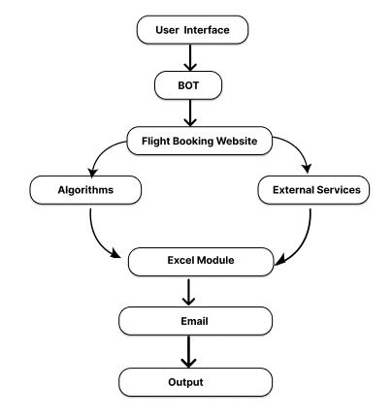
ARCHITECTURE
Department of Computer Science and Engineering
Rajalakshmi Engineering College ‹#›
Notes:
7

Slide 8
SYSTEM REQUIREMENTS
Hardware Requirements:
1.Processor:
Minimum: Dual-core (2.0 GHz or higher)
2.RAM:
Minimum: 4 GB
3.Storage:
Minimum: 50 GB free disk space
4.Network:
Stable internet connection (10 Mbps or higher)
Software Requirements:
1.Operating System:
Windows 10 or higher (64-bit)
2.RPA Tool:
UiPath (or other RPA tools)
3.Email Client:
Microsoft Outlook or Gmail
4.Data Processing:
Excel/CSV support
Department of Computer Science and Engineering
Rajalakshmi Engineering College ‹#›
Notes:
8

Slide 9
Functional Description
Module 1: Data Collection and Report Generation
Data Fetching: Extracts data from sources like databases, Excel, or CSV files.
Processing: Data is processed (e.g., calculations, filtering) to prepare for reporting.
Report Creation: Generates reports in standardized formats (PDF, Excel) using predefined templates.
Module 2: Email Sending and Distribution
Email Creation: Composes an email with the generated report attached.
Recipient Management: Sends emails to predefined or user-specified recipients.
SMTP Protocol: Uses SMTP to send emails automatically at scheduled times.
Error Handling: Monitors for errors and alerts administrators when issues occur.
Department of Computer Science and Engineering
Rajalakshmi Engineering College ‹#›
Notes:
9

Slide 10
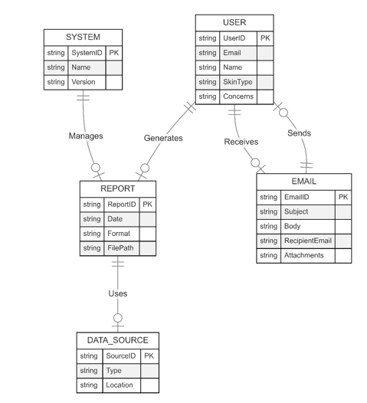
TABLE DESIGN
Department of Computer Science and Engineering
Rajalakshmi Engineering College ‹#›
Notes:
10

Slide 11
PROCESS DESIGN
Main Process: Flight Price Automation
Collects user input for travel details.
Navigates airline and travel agency websites.
Extracts and processes flight data.
Generates a report for user review.
Handles errors and validates extracted data.
Terminates the workflow and clears temporary data.
Sub Processes
1. User Input Collection: Captures travel details like locations and dates.
2. Website Navigation: Opens browser and accesses airline websites.
3. Data Extraction : Searches and extracts flight information.
4. Data Processing: Organizes and formats extracted data.
5. Report Generation : Creates structured Excel reports for comparison.
6. Error Handling and Validation : Manages issues and validates data accuracy.
7. System Termination : Closes the browser and clears temporary data.
Department of Computer Science and Engineering
Rajalakshmi Engineering College ‹#›
Notes:
11

Slide 12
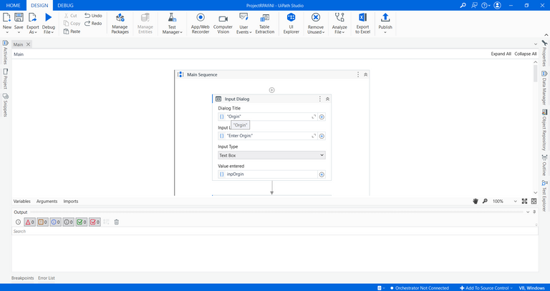
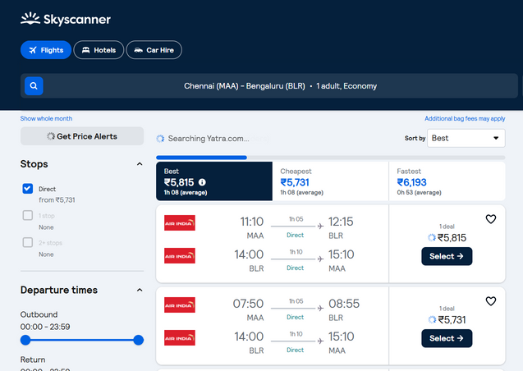
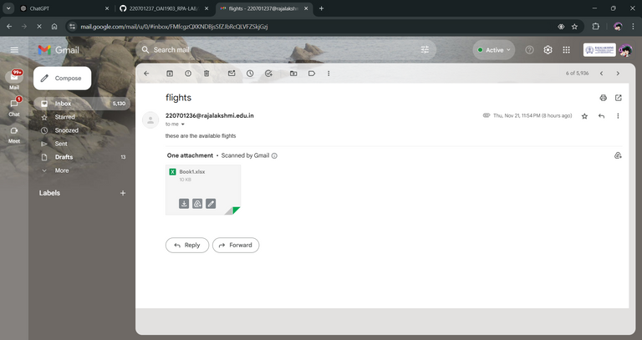
IMPLEMENTATION
Department of Computer Science and Engineering
Rajalakshmi Engineering College ‹#›
Notes:
12

Slide 13
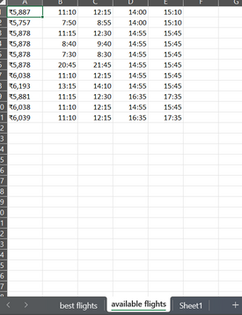
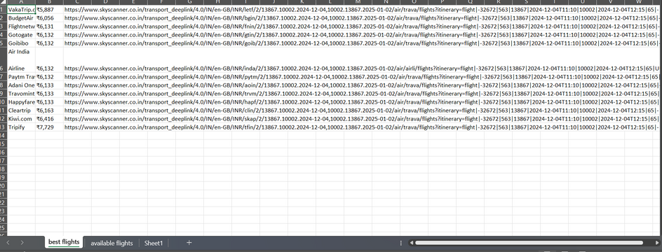
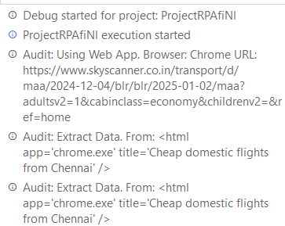
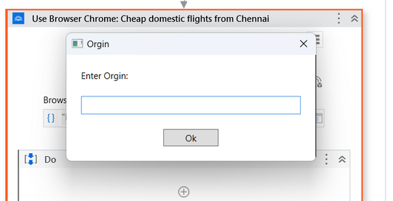
Testing
Department of Computer Science and Engineering
Rajalakshmi Engineering College ‹#›
Notes:
13

Slide 14
CONCLUSIONS
The automation workflow developed using UiPath significantly enhances the efficiency, accuracy, and consistency of repetitive tasks such as data extraction, processing, and report generation. By eliminating manual intervention, the workflow streamlines business processes, saving valuable time and reducing human error. It automates the entire process, from data collection to output generation, ensuring a smooth and reliable execution that improves overall productivity.
This solution is highly adaptable, offering scalability and customization to meet the specific needs of various industries and use cases. The integration with Excel workbooks and seamless orchestration of tasks ensures that the workflow can handle a wide range of data processing scenarios effectively.
Department of Computer Science and Engineering
Rajalakshmi Engineering College ‹#›
Notes:
14

Slide 15
Future Enhancement
Wider Website Integration
The system can be enhanced to integrate with additional airline and travel agency websites or APIs. This would allow users to compare flight options from a broader selection of platforms, ensuring they receive the most competitive prices and comprehensive information, ultimately providing a better overall experience.
Real-Time Price Monitoring and Alerts
An advanced feature could be implemented to track flight prices in real-time. This would enable the system to send automated alerts to users whenever there are significant price drops or when a selected flight reaches their desired price point, enhancing user satisfaction and helping them make informed decisions without constantly monitoring prices themselves.
Department of Computer Science and Engineering
Rajalakshmi Engineering College ‹#›
Notes:
15

Slide 16
IEEE Paper
"Email Robot Tutorial - Automate Sending Emails"
Author(s): UiPath Team
Summary: This paper discusses the process of automating email sending using robotic process automation (RPA) techniques, focusing on integrating RPA tools to streamline email communication.
"Automate Email Processing with RPA"
Author(s): Richard Schoen (Fortra)
Summary: This paper explores how RPA can be used to automate various aspects of email processing, from handling inbound messages to organizing data and triggering actions based on email content.
"Intelligent Email Processing using Robotic Process Automation"
Author(s): IEEE Research Team
Summary: This paper focuses on using intelligent systems powered by RPA for smarter email processing, including automated data extraction, analysis, and decision-making based on the email content.
"Automation of Report Generation and Distribution in RPA"
Author(s): IEEE Research Team
Summary: This paper highlights how RPA can automate the generation and distribution of reports, improving efficiency by minimizing manual intervention in preparing and sending reports.
"Process Automation for Email-based Data Entry and Report Management"
Author(s): IEEE Research Team
Summary: This paper discusses how RPA can automate email-based data entry and report management, including the collection, processing, and dissemination of data.
Department of Computer Science and Engineering
Rajalakshmi Engineering College ‹#›
Notes:
16

Slide 17
References
[1] Kuppusamy, Palanivel& Joseph K, Suresh. (2020). Robotic Process Automation to Smart Education. 3775.
[2] Patil, Dr & Mane, Vinod & Patil, Dr. (2019). Social Innovation in Education System by using Robotic Process Automation (Rpa). International Journalof Innovative Technology and Exploring Engineering. 8. 3757-3760. 10.35940/ijitee.K2148.0981119.
[3] Elkhatat, A.M., Elsaid, K. & Almeer,S. Evaluating the efficacy of AI content detection tools in differentiating between human and AI- generated text. Int J Educ Integr 19, 17 (2023). https://doi.org/10.1007/s40979-023-00140-5
[4] H. Alamleh, A.A. S. AlQahtani and A. ElSaid, "Distinguishing Human-Written and ChatGPT-Generated Text Using Machine Learning,"2023 Systems and Information Engineering Design Symposium (SIEDS), Charlottesville, VA, USA, 2023, pp. 154-158, doi: 10.1109/SIEDS58326.2023.10137767.
[5] Tomáš Foltýnek, Norman Meuschke, and Bela Gipp. 2019. Academic Plagiarism Detection: A Systematic Literature Review. ACM Comput. Surv. 52, 6, Article 112 (November 2020), 42 pages. https://doi.org/10.1145/3345317
[6] H. A. Chowdhury, D. K. Bhattacharyya, “Plagiarism: Taxonomy, Tools and DetectionTechniques”, 19th NationalConvention on Knowledge, Library and Information Networking, 2018.
Department of Computer Science and Engineering
Rajalakshmi Engineering College ‹#›
Notes:
17

Slide 18
Queries
Notes:
18

Slide 19
Demonstration
Notes:
19

Slide 20
Thank You
Notes:
20

